Slide 1

COLLEGE OF ENGINEERING, TRIVANDRUM
TECHNIQUES TO IMPROVE QUALITY OF SERVICE (QoS)
BY
ROHIT M - 49

Slide 2

CONTENTS
1
What is QoS?
2
Techniques to Improve
2.1
Scheduling
3.1
FIFO Queuing
3.2
Priority Queuing
3.3
Weighted Fair Queuing

Slide 3
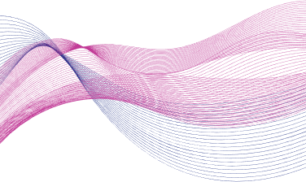
WHAT IS QoS?
Quality of Service (QoS) refers to mechanisms that prioritize and manage network traffic to ensure critical applications receive the necessary resources and performance, reducing issues like packet loss, latency, and jitter.
Example:
VoIP: Ensuring clear and reliable voice calls over IP networks.
Video Streaming: Delivering smooth and uninterrupted video playback.

Slide 4

TECHNIQUES
01
Scheduling
02
Traffic Shaping
03
Resource Reservation
04
Admission Control

Slide 5
SCHEDULING
Packets from different flows arrive at a switch or router for processing.
A good scheduling technique treats the different flows in a fair and appropriate manner.
Multiple queues are present each with different priority levels. The scheduler decides the type of treatment to be given to the traffic in each queue. When traffic is available, the scheduler maps it to the appropriate queue.
For example, video and voice traffic are kept is queued with higher priority than background traffic.
Several scheduling techniques are designed to improve the quality of service.

Slide 6
FIFO QUEUING
SCHEDULING TECHNIQUES
PRIORITY QUEUING
WEIGHTED FAIR QUEUING

Slide 7
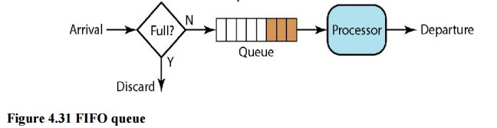
FIFO QUEUING
The principle of a queue or first-come first serve behavior: what comes in first is handled first, what comes in next waits until the first is finished etc.
All packets are treated equally by placing them into a single queue, then servicing them in the same order they were placed in the queue.
If the average arrival rate is higher than the average processing rate, the queue will fill up and new packets will be discarded.

Slide 8
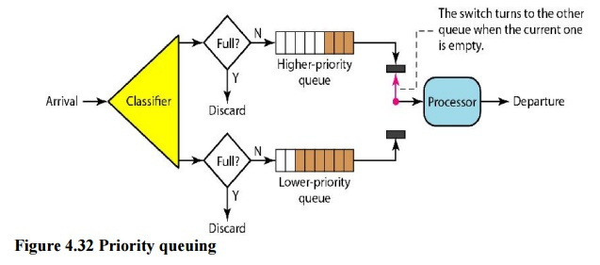
PRIORITY QUEUING
In priority queuing, packets are first assigned to a priority class. Each priority class has its own queue.
The packets in the highest-priority queue are processed first. Packets in the lowest-priority queue are processed last.
A priority queue can provide better QoS than the FIFO queue because higher priority traffic, such as multimedia, can reach the destination with less delay.
Drawback : If there is a continuous flow in a high-priority queue, the packets in the lower-priority queues will never have a chance to be processed. This is a condition called starvation.
Solution : Ageing Technique

Slide 9
WEIGHTED FAIR QUEUING
The packets are still assigned to different classes and admitted to different queues.
The queues are weighted based on the priority of the queues; higher priority means a higher weight.
The system processes packets in each queue in a round-robin fashion with the number of packets selected from each queue based on the corresponding weight.
For example, if the weights are 3, 2, and 1, three packets are processed from the first queue, two from the second queue, and one from the third queue. If the system does not impose priority on the classes, all weights can be equal.
In shared network resources - fair distribution of bandwidth - prevents network congestion and ensures smooth data transmission.

Slide 10
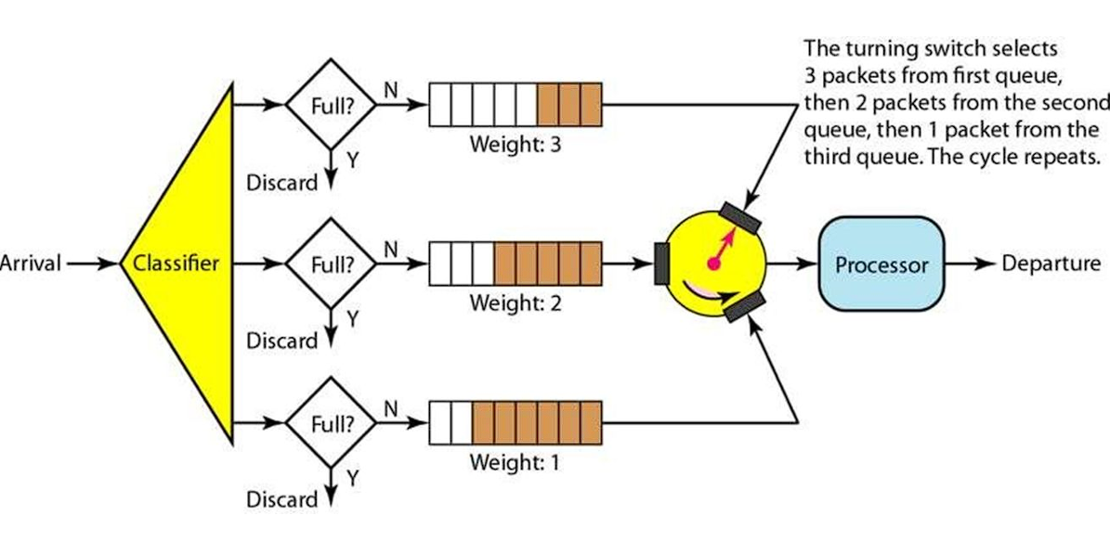

Slide 11
THANK YOU
BY ROHIT M

